Slide 1
Google Stock Prices
Harish Ram
DATS6450_15 – Time Series and modeling
Final project presentation

Slide 2
About the data
DJIA 30 Stock Time Series from Kaggle
The author web-scrapped the data from Google finance using “pandas_datareader”
The Close price is the variable of interest in this project
Contains 3020 rows and 7 columns
Column Name | Data Type | Description
Date | String | In format: yy-mm-dd
Open | float | Price of the stock at market open ($USD)
High | float | Highest price reached in the day ($USD)
Low | float | Lowest price reached in the day ($USD)
Close | float | Price of the stock at market close ($USD)
Volume | int | Number of shares traded
Name | String | The stock’s ticker name

Slide 3
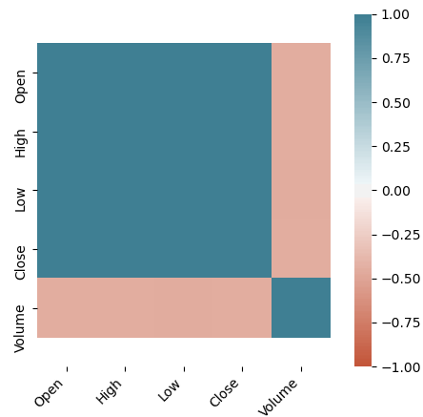
Correlation Matrix

Slide 4
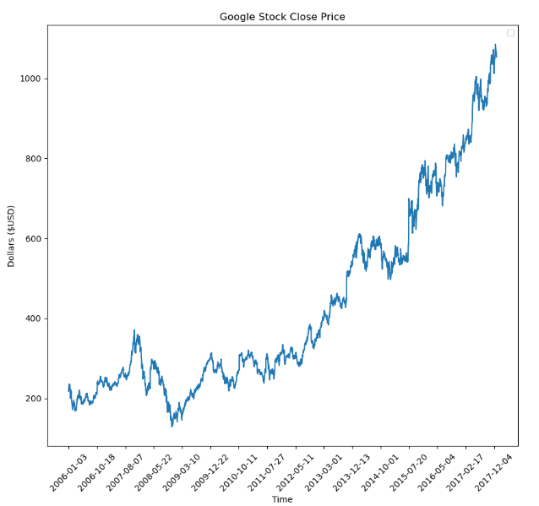
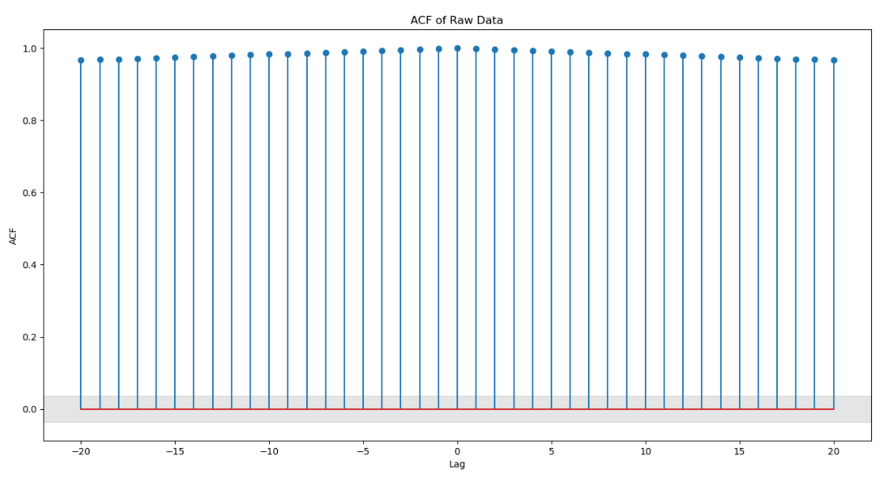
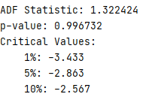
Stationarity Analysis: Observations

Slide 5
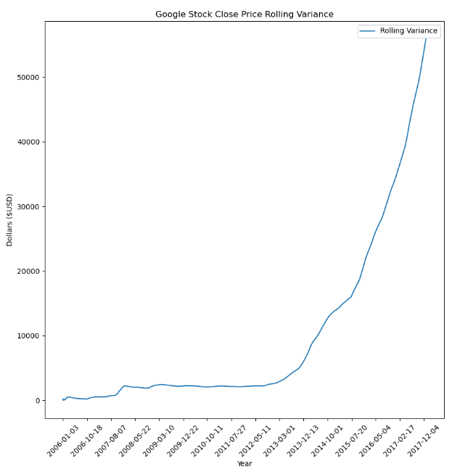
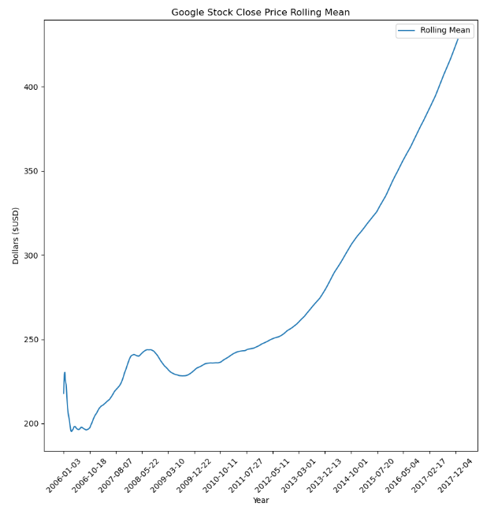
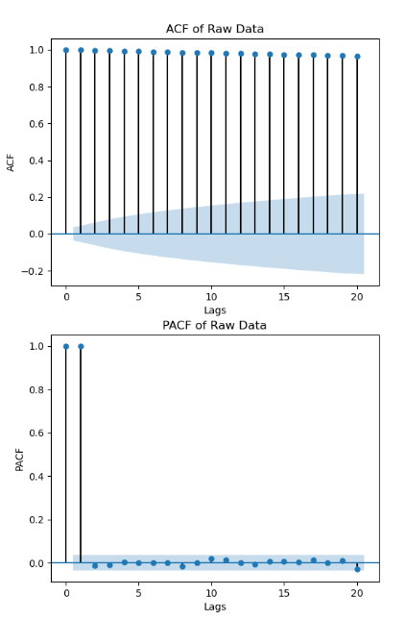
Stationarity Analysis: Observations

Slide 6
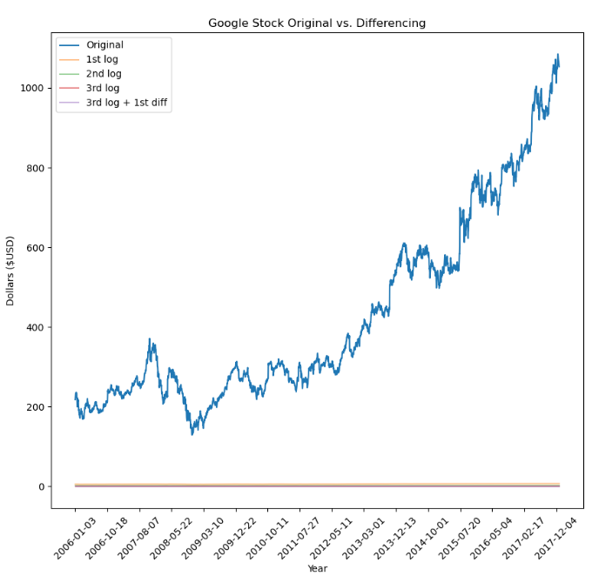
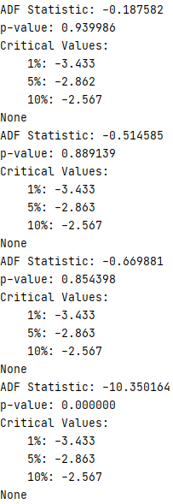
Stationarity Analysis: Transformation

Slide 7
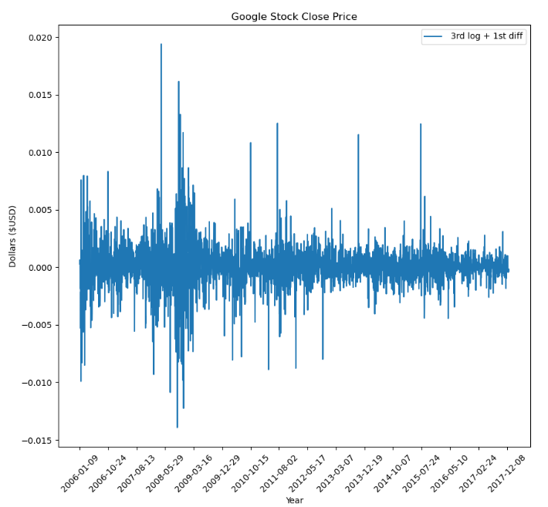
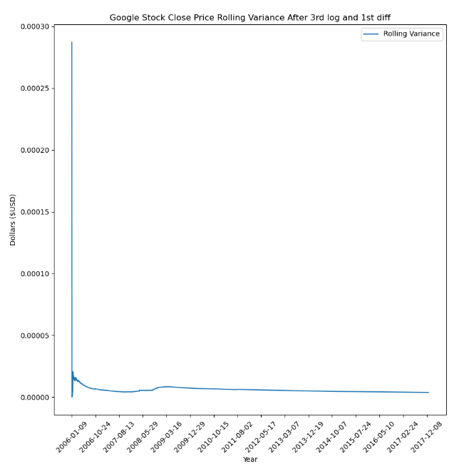
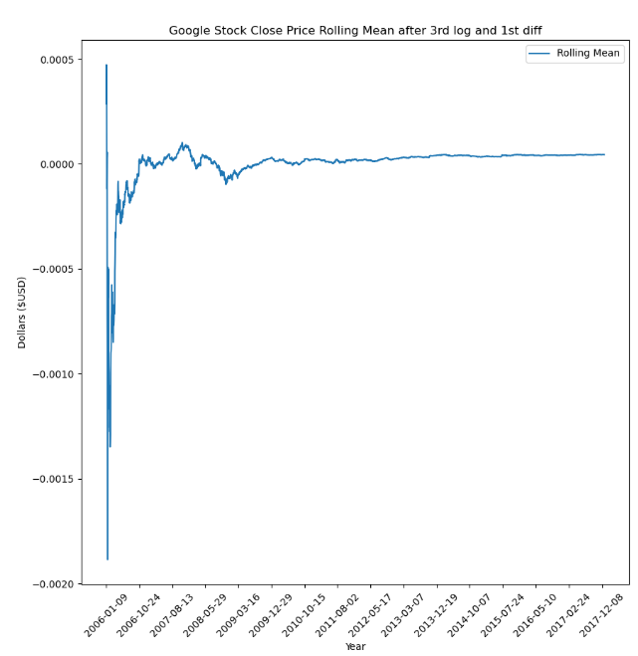
Stationarity Analysis: Transformation

Slide 8
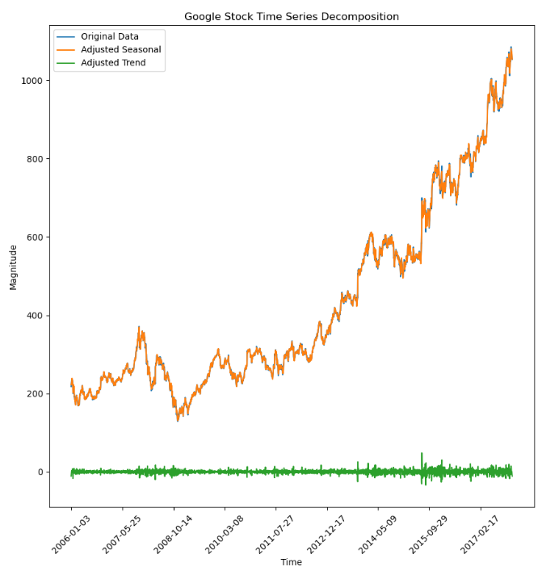
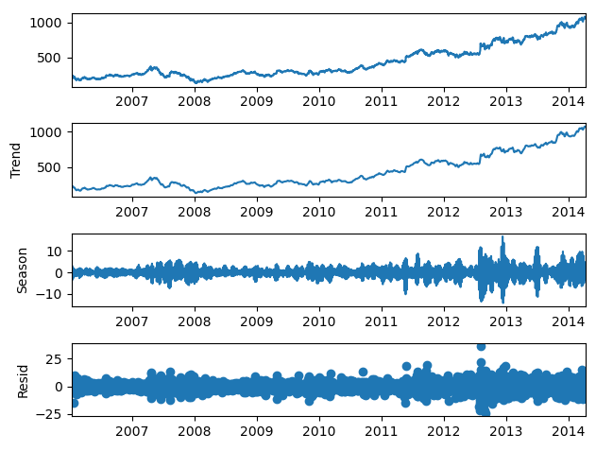
Time Series Decomposition

Slide 9
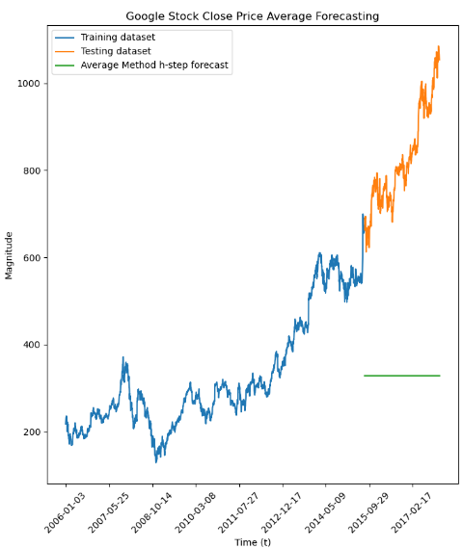
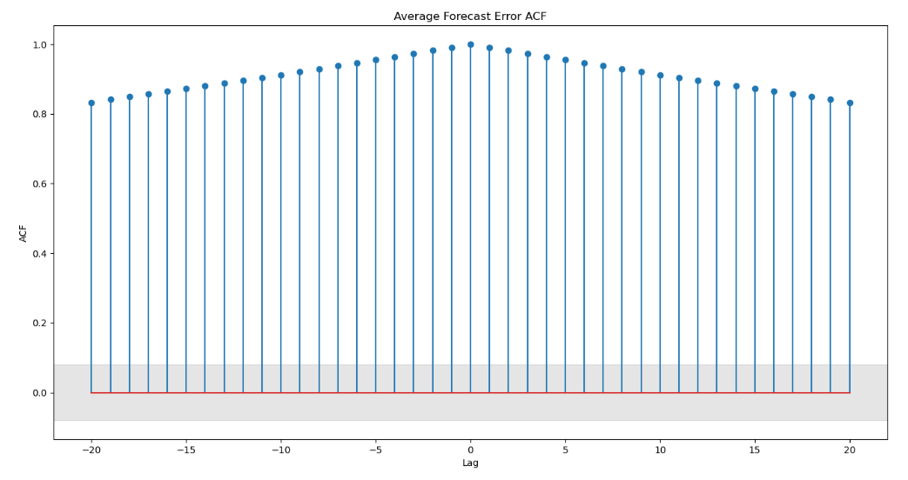

Base Model: Average Method

Slide 10
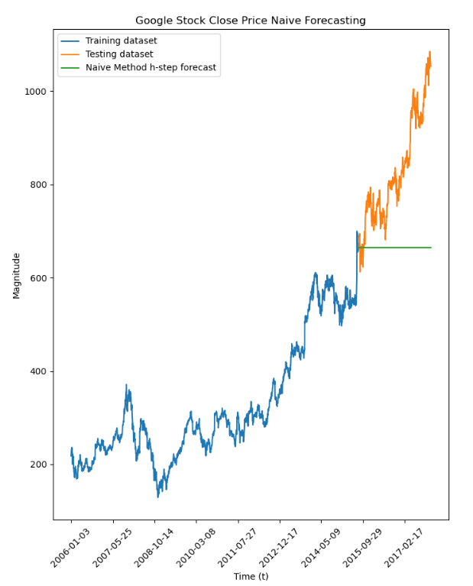
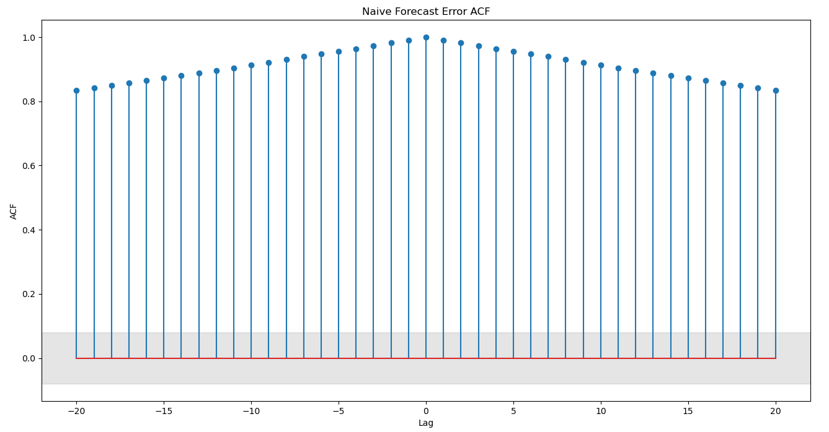
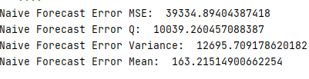
Base Model: Naïve Method

Slide 11
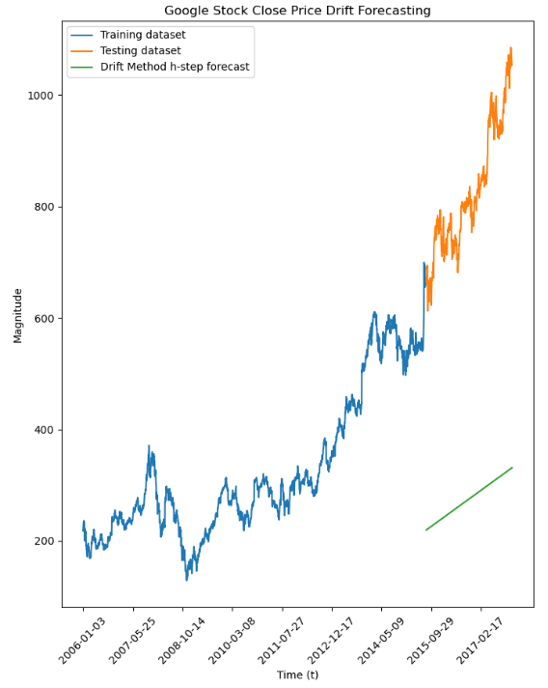
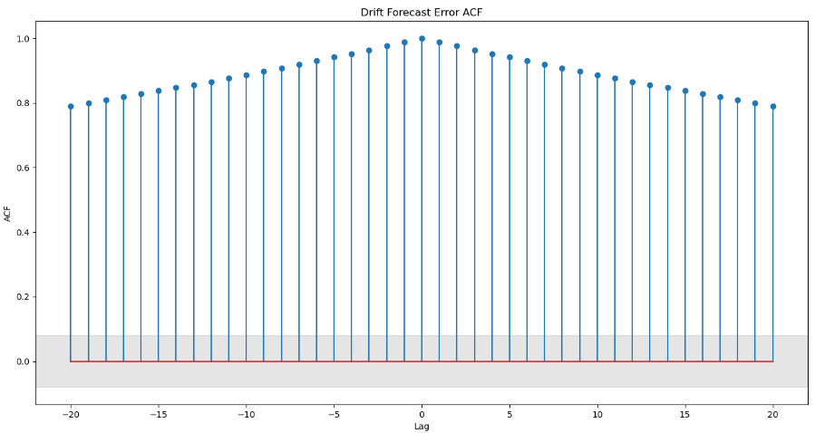
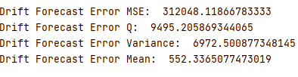
Base Model: Drift Method

Slide 12
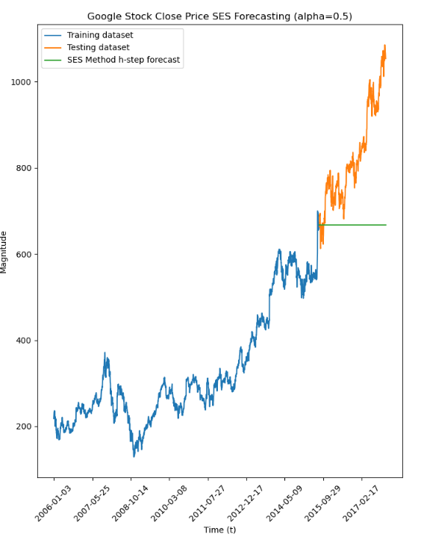
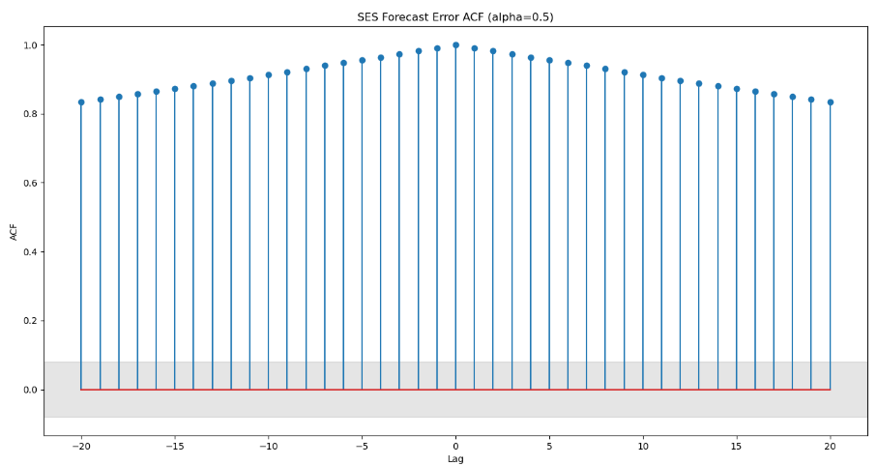

Base Model: Simple Exponential Smoothing (alpha=0.5)

Slide 13
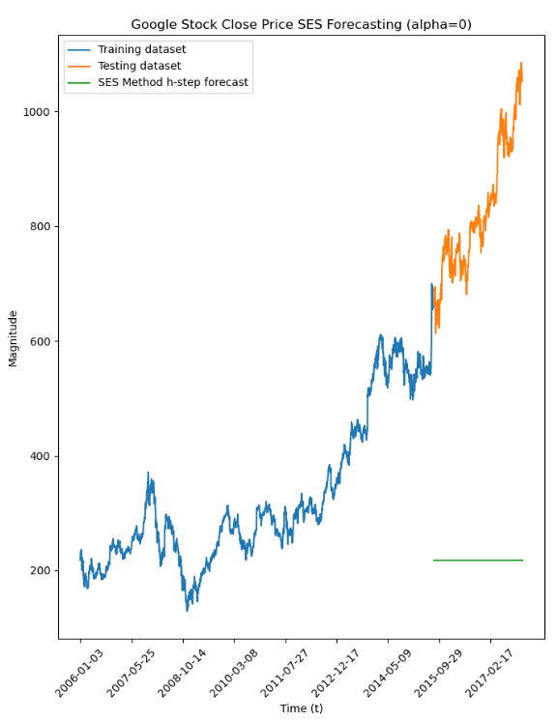
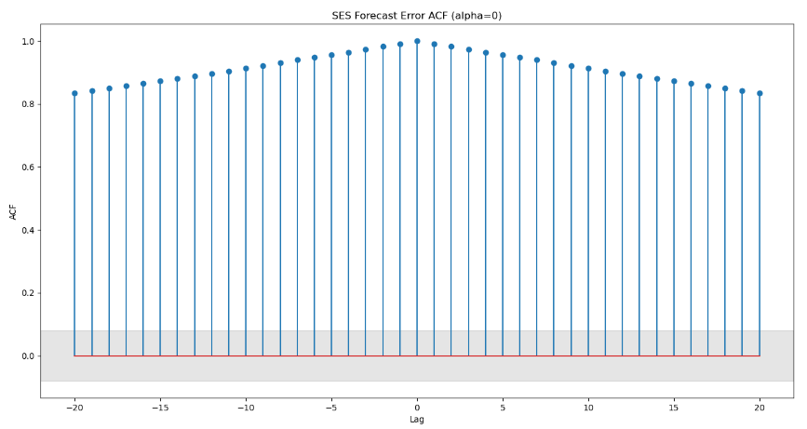

Base Model: Simple Exponential Smoothing (alpha=0)

Slide 14
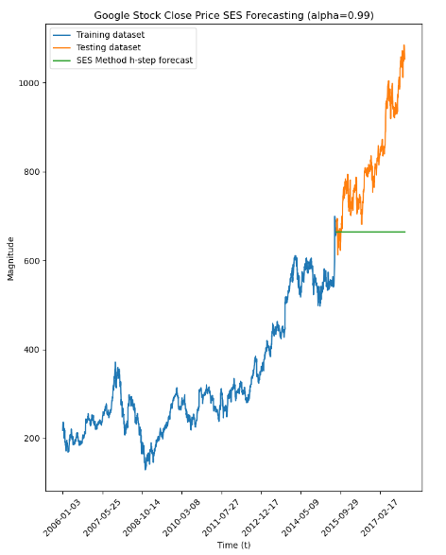
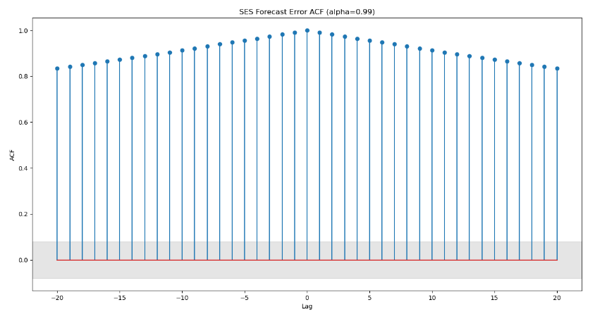

Base Model: Simple Exponential Smoothing (alpha=0.99)

Slide 15
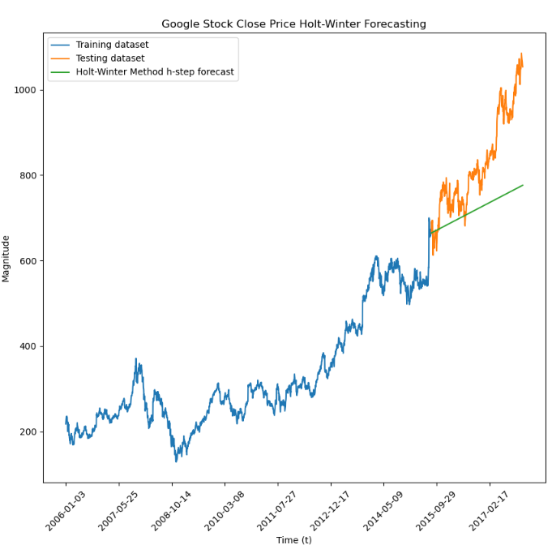
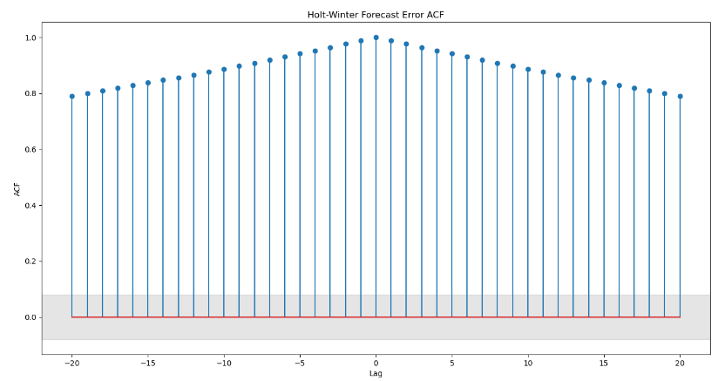
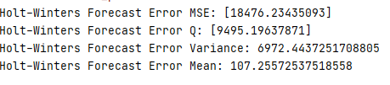
Holt-Winters (Seasonal=None, Trend=‘Additive’, damped = False)

Slide 16
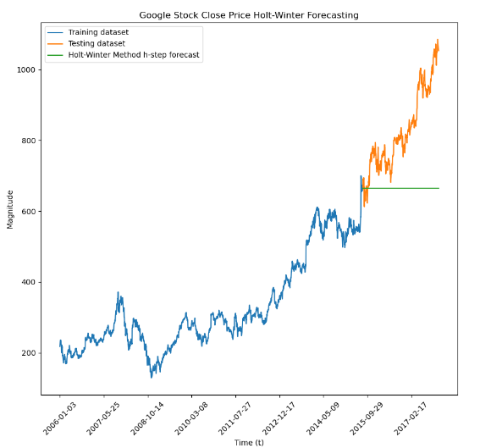
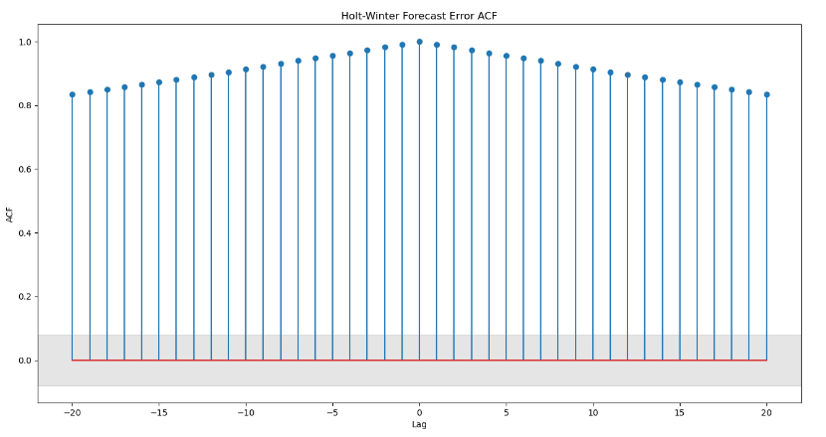

Holt-Winters (Seasonal=None, Trend=‘Additive’, damped=True)

Slide 17
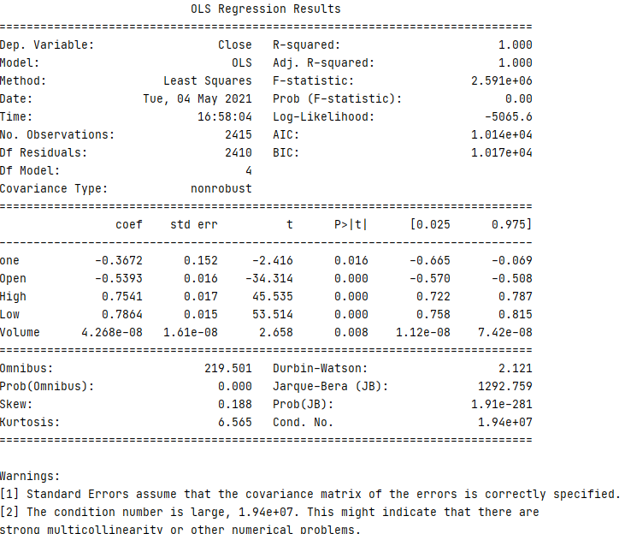

Feature Selection
“one” signifies a constant that was added to X_train and X_test
“Open”, “High” and “Low” has a p-value<0.05 and a confidence interval without 0, so it should be statistically significant
From the correlation matrix, “Volume” does not correlate with the target variable, “Close”
Removed the constant first to see effect on Adj. R^2, AIC and BIC

Slide 18
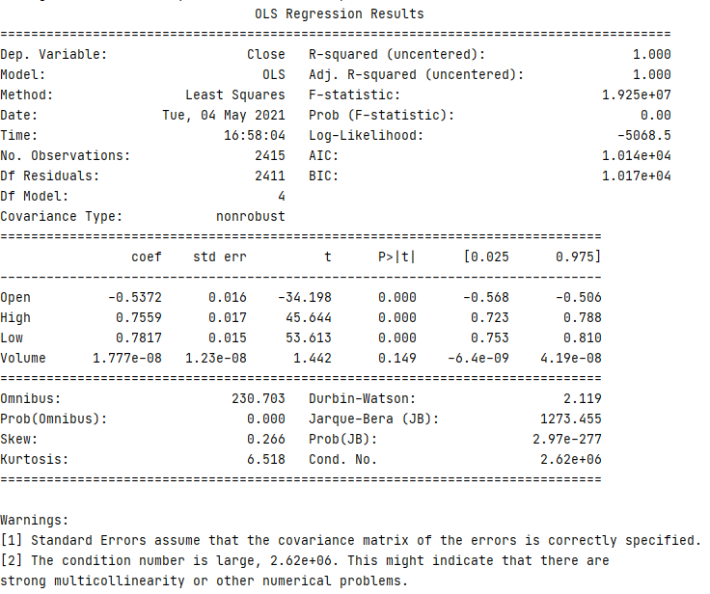
Feature Selection
Removing the constant made the condition number decrease by about 1000
“Volume” variable now shows a p-value>0.05 and the confidence interval contains 0
“Volume” is statistically insignificant and should be removed

Slide 19
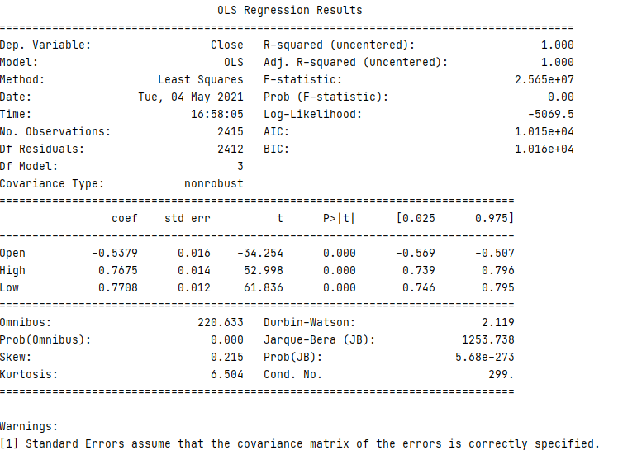
Feature Selection
After removing “Volume” the condition number is now very low
Adjusted R^2 remains unchanged

Slide 20
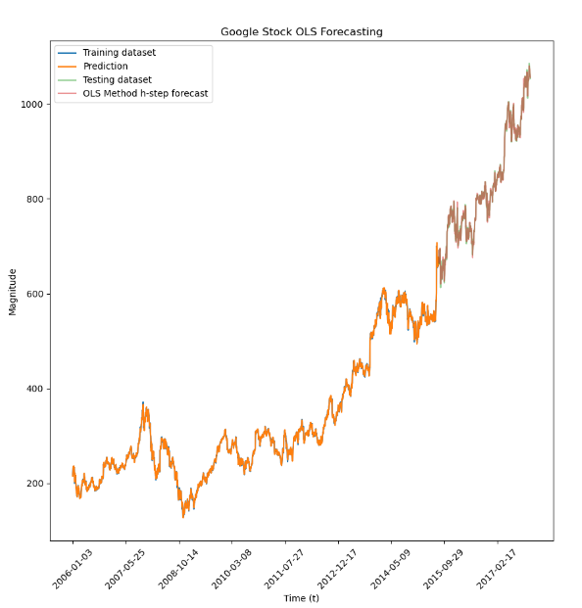
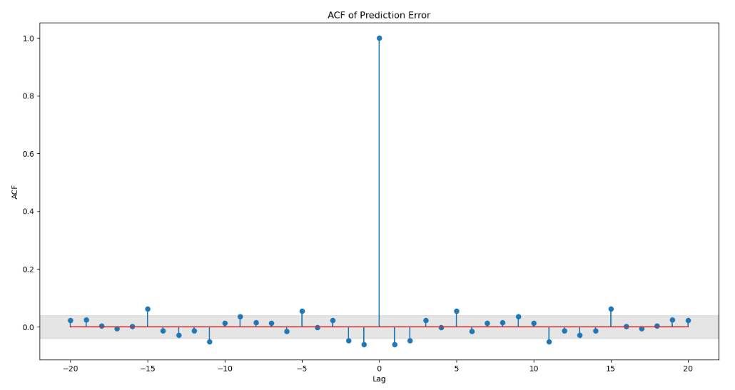

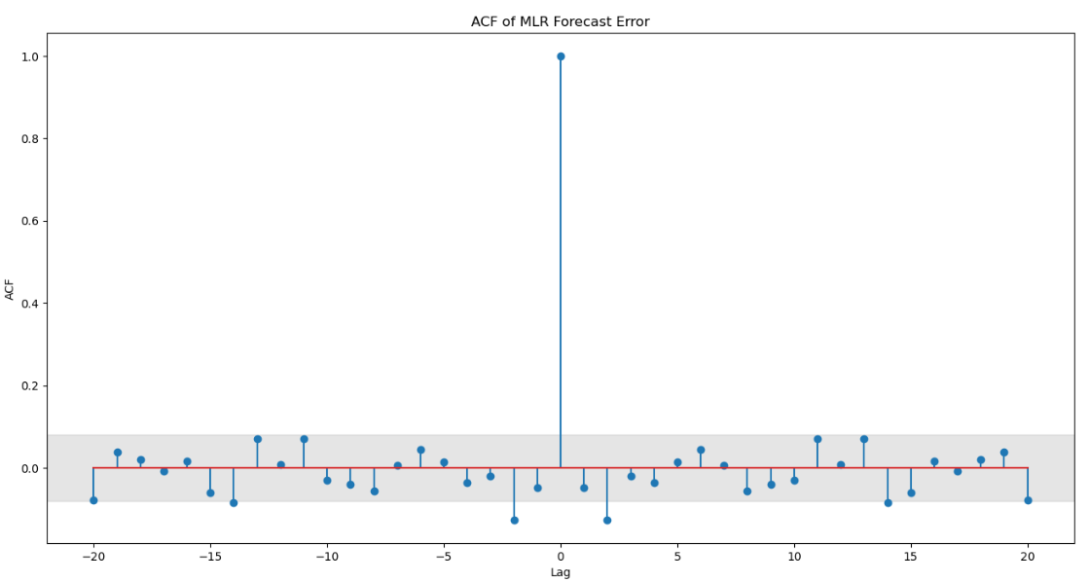
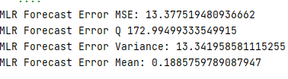
Multiple Linear Regression

Slide 21
Multiple Linear Regression Model Analysis
t-test:
All the p-values for each coefficient (Open, High, Low) are less than 0.05
We can reject the null hypothesis and conclude that all variables in the model are significant predictors of Close price.
F-test
The p-value for the F-statistic is less than 0.05 which means we can reject the null hypothesis
The fit of the intercept-only model is significantly reduced compared to our model
The strength of the relationship between the features and dependent variable in our model is statistically significant

Slide 22
Multiple Linear Regression Model Analysis
Adjusted R^2 = 1.0
100% of the target variable is explained by “Open”, ”High” and “Low”
AIC increased by 0.001
BIC decreased by 0.001

Slide 23
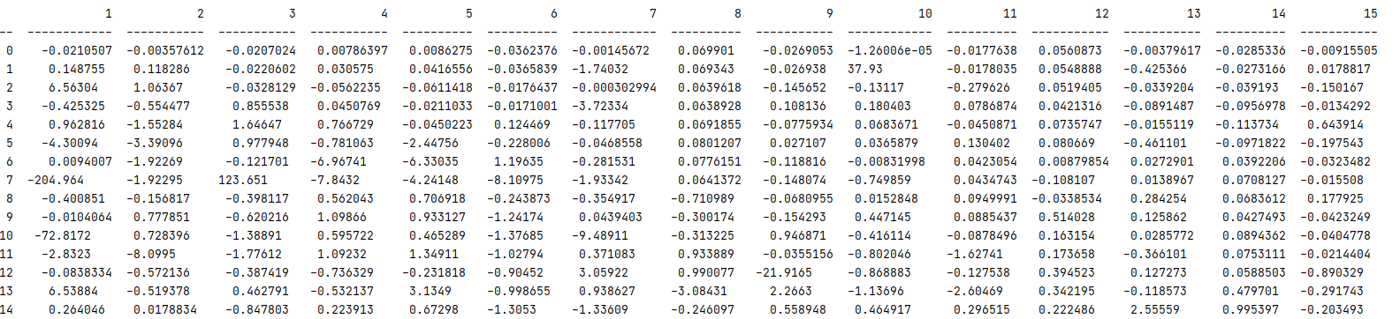
Generalized Partial Autocorrelation (GPAC)
ARMA(8,0)
ARMA(12,0)

Slide 24
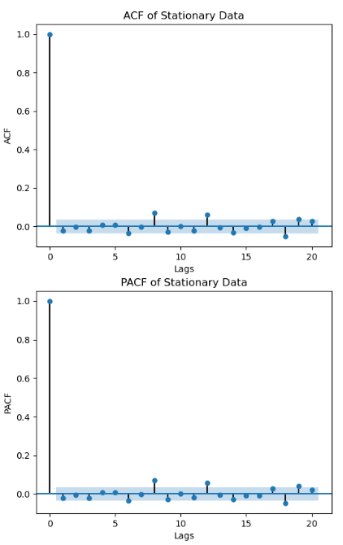
ACF/PACF Parameter Estimation
ACF:
There are stems outside of the insignificant region at lag 8 and 12
“Cut-off” at 8 and 12 indicate AR order
PACF:
“tail-off” or decay from the beginning

Slide 25
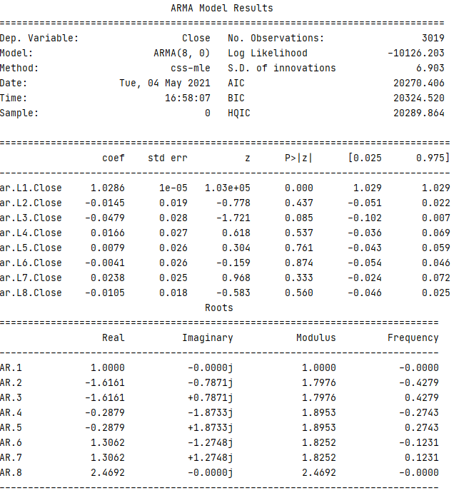
LM Algorithm Diagnostic Analysis: ARMA(8,0)
Parameter Estimates:
The column of coefficients do not show the coefficients shown in the GPAC
Confidence Interval:
There is 0 in the confidence interval for every coefficient besides the AR(1)
This shows that the model is biased
Since the order of MA is 0, there are no zeros/pole cancellations
Chi-Square Test:
The Q value calculated from the error of model.predict() is less than the critical value, so we can reject the null hypothesis and conclude that the residuals are white

Slide 26
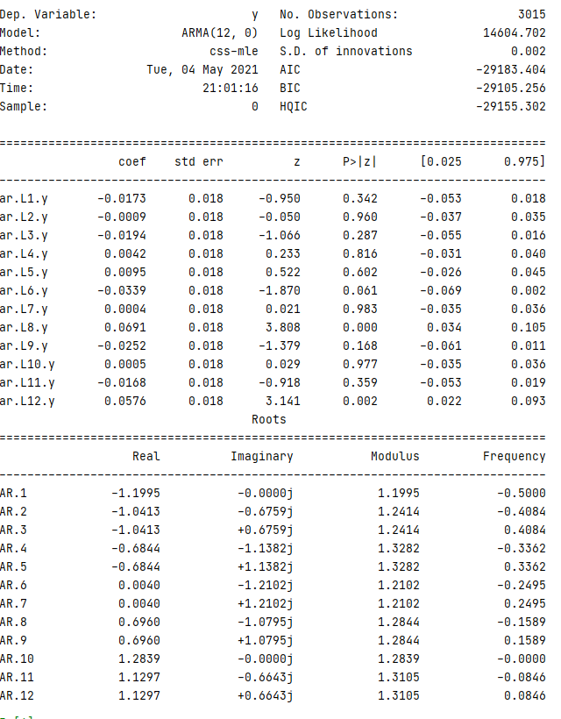
LM Algorithm Diagnostic Analysis: ARMA(12,0)
Parameter Estimates:
The coefficient shown in the GPAC at k = 12 reflects the coefficient of AR(12) in the model summary
Confidence Interval:
There is 0 in the confidence interval for every coefficient besides AR(12) which indicates this is the only coefficient that is statistically significant
This shows that the model is biased for the first 11 coefficients, but not for the last one
Since the order of MA is 0, there are no zeros/pole cancellations
Chi-square Test:
Through the chi-square test of whiteness, the calculated Q value based on the prediction error from this model is less than the chi-critical value indicating the residuals are white

Slide 27
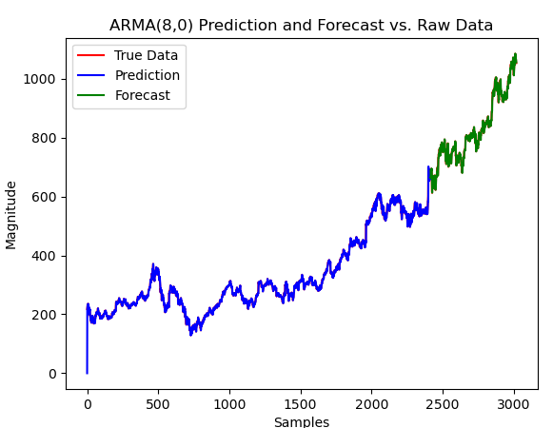
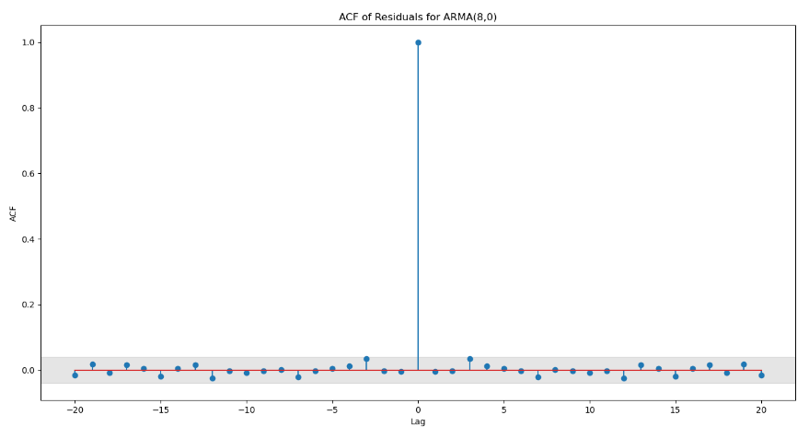

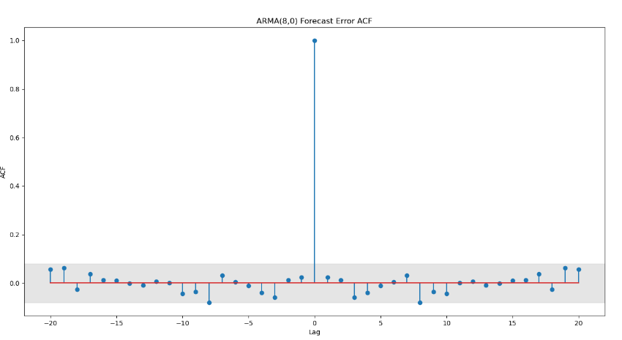

ARMA(8,0)

Slide 28
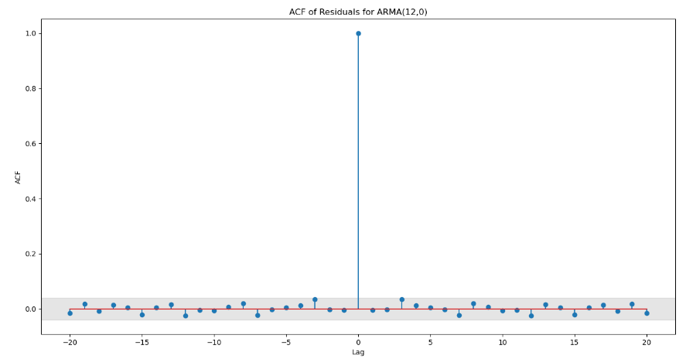

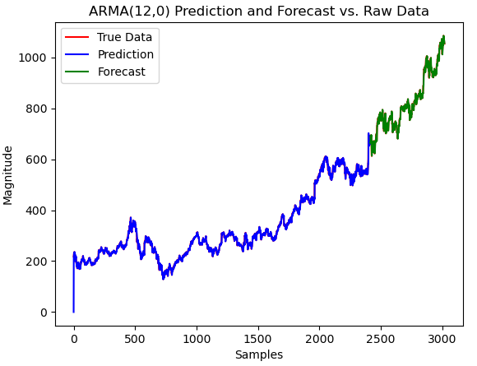
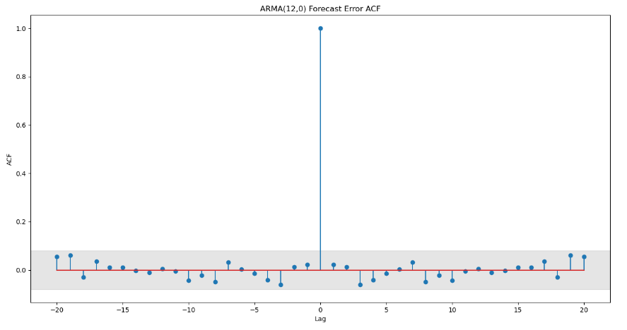

ARMA(12,0)

Slide 29




Model Comparison

Slide 30


Model Selection: Multiple Linear Regression

